Slide 1
Rain forecasting
Using Machine Learning for Water Management
By Rajnish Kashyap

Slide 2
TABLE OF CONTENTS
Introduction
Eda & Data Wrangling
Feature Engineering
Model Building
The project aims to predict
whether it will rain tomorrow
using historical weather data,
applying data science and
machine learning techniques.
Performed thorough exploratory data
analysis, handled missing values,
visualized distributions, and cleaned the
dataset for modeling.
Converted categorical variables, created
new meaningful features, and scaled
numerical data to enhance model
performance.
Trained multiple classification models
including Logistic Regression, Random
Forest, and XGBoost, achieving high
accuracy and model evaluation metrics.

Slide 3

INTRODUCTION
Welcome to the Rain Forecasting for
Mumbai project.
In this project, we aim to develop a machine
learning model to accurately forecast monthly
rainfall levels in Mumbai, India.
This forecast will play a critical role in:
➤ Optimizing water resource planning and allocation.
➤ Ensuring uninterrupted water supply throughout the year.
➤ Reducing the impact of droughts and water scarcity.

Slide 4
Problem & Objective
Problem
Objective
Mumbai experiences highly seasonal
rainfall, primarily concentrated during
the monsoon months.
A lack of accurate forecasting can lead to:
➤Inefficient reservoir management
➤ Inadequate infrastructure planning during rainy/dry periods
➤ Increased risk of water shortages or wastage
The objective of this project is to build a
machine learning model that forecasts
monthly rainfall in Mumbai using
historical rainfall data.
By anticipating future rainfall patterns:
➤ Water authorities can plan ahead for conservation or storage
➤ Infrastructure projects can be timed efficiently
➤ Mumbai’s resilience to extreme weather conditions can be strengthened

Slide 5
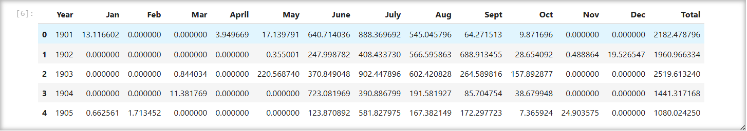
Total Rows 121 Total Features 14
Dataset Overview
Monthly Rainfall Data
The dataset records total rainfall (in mm) for
each month from January to December, along
with a yearly Total value.
Historical Range
Data spans over multiple years starting from
1901, providing long-term insights into annual
and seasonal rainfall trends.
Seasonal Patterns
Most rainfall is concentrated in
June to September, aligning
with the typical monsoon season
In regions like India.

Slide 6
Eda & Data Wrangling
Initial Column-Wise Summary
Descriptive Statistics Summary
The dataset contains 121 rows and 14
columns, covering rainfall data from 1901 to 2021.
Each row represents a year, with monthly
rainfall values and an annual total.
All columns have complete data with no
missing values.
Monthly and total rainfall values are in float format; the Year column is integer type.
No data type conversions are currently
required.
Monsoon Dominance: June–Sept have high rainfall with large variation.
Dry Months: Jan–May & Nov–Dec have very low or near-zero rainfall.
High Variability: Large standard deviations show yearly fluctuations.
Dry Spells: Zero values in many months are common.
Annual Spread: Total rainfall ranges from ~1058 mm to 3563+ mm.

Slide 7
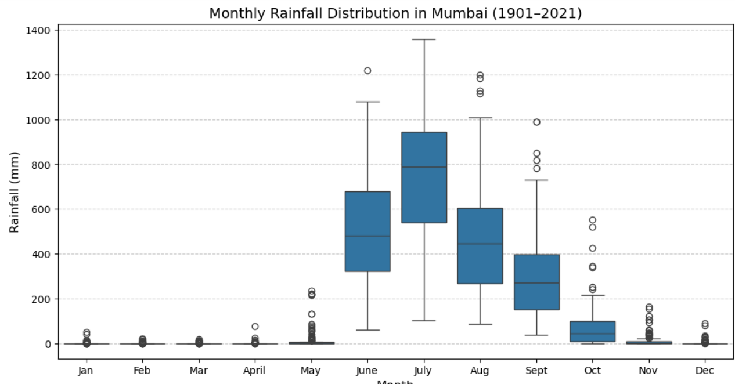
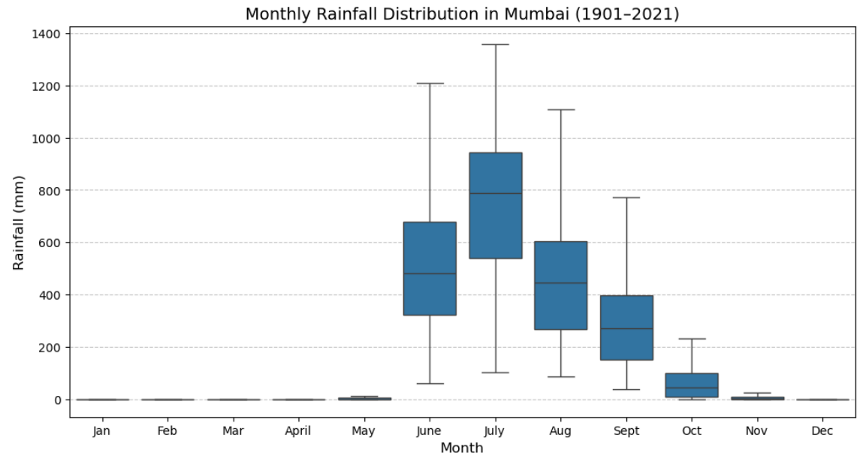
Outlier Analysis
Key Observation
May: from 234.39 mm → 10.52 mm
Dec: from 90.04 mm → 0.44 mm
Feb: from 21.10 mm → 0.38 mm
April: from 75.54 mm → 0.49 mm

Slide 8
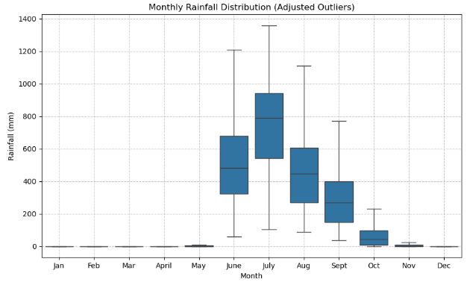
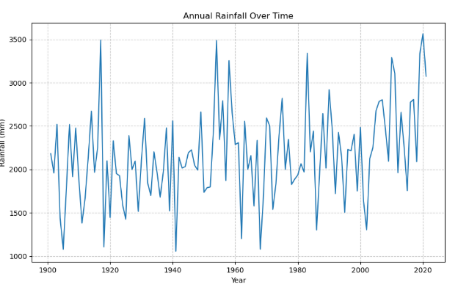
Monthly Rainfall Distribution
Data Visualization
Annual Rainfall Overtime

Slide 9
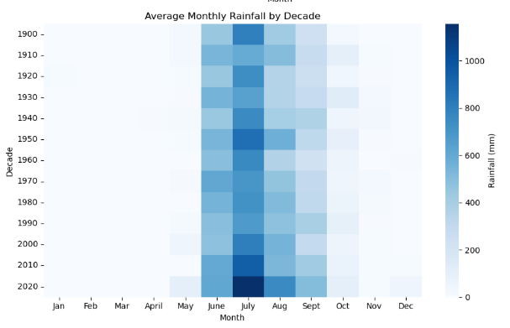
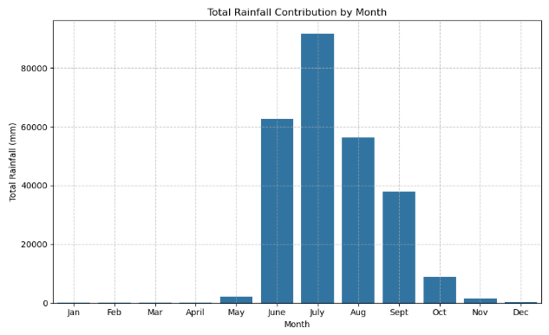
Average Monthly Rainfall by Decade
Data Visualization
Total Rainfall Contribution by Month

Slide 10
Feature Engineering
Rainfall_Lag1
Lag Features
Month Feature
Rainfall_Lag2
Rolling_Mean_3M
Month
Trend_12M
Rolling Averages
Rolling_Mean_3M captures
short-term trends and
smoothens fluctuations,
Making seasonal effects more
visible.
Trend_12M identifies long-term annual trends, which are useful in understanding gradual climate shifts or monsoon cycles.
Rainfall patterns are often autocorrelated. Including Rainfall_Lag1 and Rainfall_Lag2 helps the model learn from previous months' rainfall values.
Rainfall is highly seasonal. Including the Month as a numerical feature helps the model learn monthly seasonality, crucial in Indian rainfall patterns (e.g., monsoon months vs dry months).

Slide 11
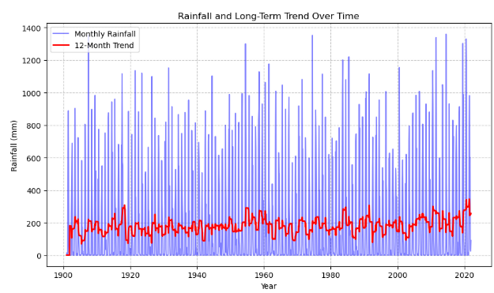
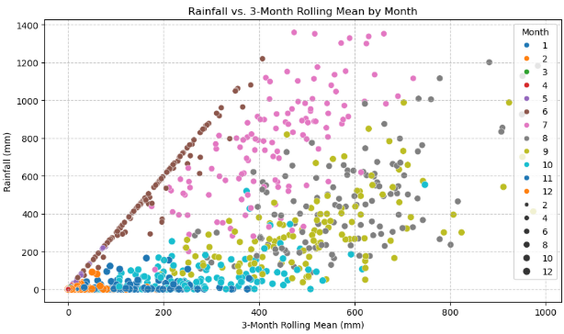
Visualization with Engineered Features
Rainfall and Long-Term Trend Over Time
Rainfall vs. 3-Month Rollling Mean by Month

Slide 12
Model Building
Time-Series Forecasting is used to model and predict Mumbai's rainfall, comparing multiple algorithms to find the most accurate.
 | Forecasting Model we’ll use
➤ ARIMA | A classic statistical model suited for univariate time series, capturing trends and seasonality.
➤ Prophet | A robust model that handles seasonality, trend shifts, and holiday effects with minimal tuning.
➤XGBoost | A powerful machine learning model that captures nonlinear patterns and dependencies in time series using lag-based features.

Slide 13
Model Implementation
ARIMA
PROPHET
XGBOOST
Trained with order=(1,1, 1)
And seasonal_order=(1, 1,
1, 12).
Forecasted values for
2011–2021.
Evaluated using MAE and RMSE.
Used engineered features:
Rainfall_Lag1, Rainfall_Lag2,
Rolling_Mean_3M, Month,
And Trend_12M.
Trained with 100 estimators,
max_depth=5.
Made predictions for 2011
2021.
Evaluated using MAE and
RMSE.
Automatically detects yearly
Seasonality.
Robust to missing data and
outliers.
Requires ds (date) and y
(target) columns.

Slide 14
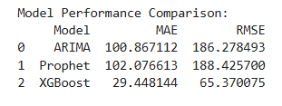
Evaluation & Comparison
➤ ARIMA & Prophet showed similar performance with high error values
(MAE ~100, RMSE ~186–188).
➤ XGBoost significantly outperformed others, with much lower MAE
(29.45) and RMSE (65.37).
➤ XGBoost is the most accurate model for forecasting Mumbai’s rainfall in this analysis.

Slide 15
Fine-Tuning XGBOOST
Features Used:
Rainfall_Lag1, Rainfall_Lag2, Rolling_Mean_3M, Month, Trend_12M
Splitting data:
X_train / y_train: 1901-2010
X_test / y_test: 2011-2021
Best Parameteres
learning_rate: 0.1
max_depth: 3
min_child_weight: 3
n_estimators: 300
subsample: 0.7
Tuned XGBOOST Performance
MAE: 21.01699890560576
RMSE: 43.57881750382878

Slide 16
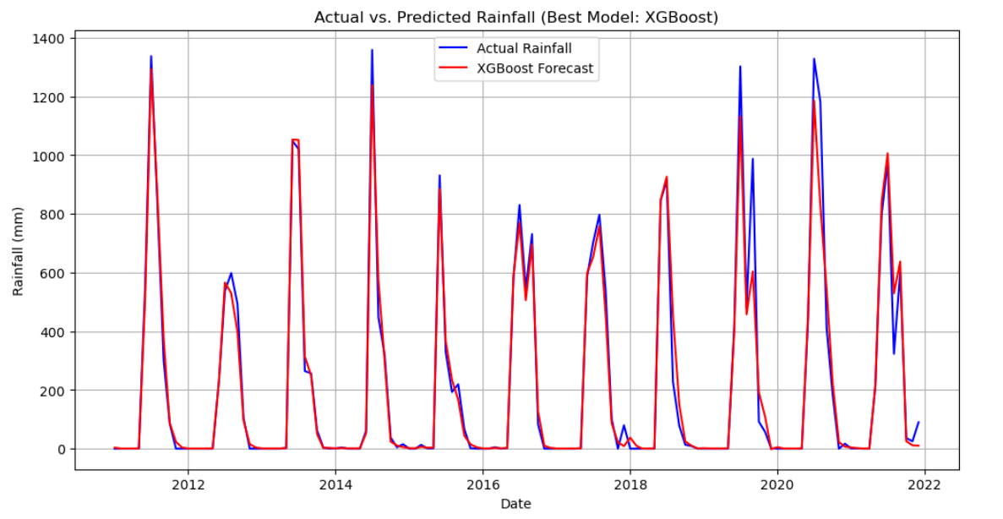
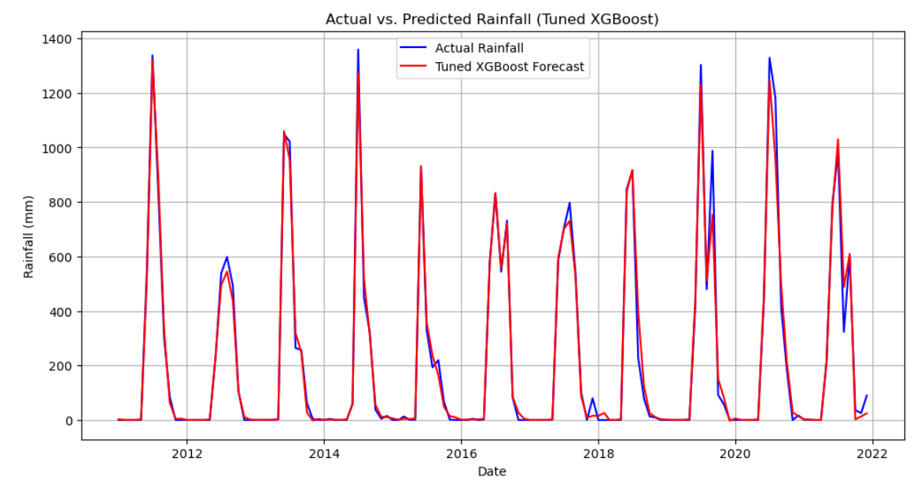
Visualizing Prediction
🔵 Blue Line: Actual rainfall (2011–2021)
🔴 Red Line: XGBoost predictions
➤ Strong alignment with seasonal rainfall
peaks.
➤ Accurate tracking of monsoon patterns
and dry Periods.
➤ Visually confirms model’s predictive power.

Slide 17
Business Question
➤ How can rainfall forecasts improve reservoir management in Mumbai?
Accurate predictions (MAE: 27.89 mm) help optimize water storage, ensuring
reservoirs are neither overfilled nor depleted.
➤ What infrastructure adjustments can be made based on predictions?
Forecasts enable timely flood control measures, like reinforcing drainage systems during
predicted monsoon peaks.
➤ How can this model scale to other cities with rainfall challenges?
The methodology (EDA, feature engineering, XGBoost) can be applied to other regions with
similar historical rainfall data.
➤ Can we reduce water scarcity risks during dry months?
Yes, by using forecasts to store water efficiently during monsoons for use in dry periods
(e.g., January–March).
➤ What cost savings might result from better rainfall planning?
Improved predictions can minimize flood damage costs and reduce water wastage, potentially
saving millions annually.

Slide 18
Conclusion
Further Improvement
Integrate climate variables (e.g., temperature, humidity) to enhance model accuracy.
Explore advanced models like LSTM for capturing long-term rainfall dependencies.
Build a real-time forecasting dashboard using tools like Streamlit for decision-making.
Project Summary
This project uses machine learning to forecast monthly rainfall in Mumbai (2011–2021).
XGBoost outperformed ARIMA and Prophet, achieving an MAE of 27.89 mm & After fine-tuning 21.01
The model captures seasonal patterns, enabling better water management and planning.

Slide 19
thanks!
By Rajnish Kashyap

